Slide 1



YouTube Video Downloader
By: Nick Howley

Slide 2
Project Information
Team Members: Nick Howley
Title: YouTube Video Downloader
Tagline: With this application, you have the power to download any YouTube video you want, to take with you on the go!
Github Repository: https://github.com/ksu-is/Youtube-Downloader/tree/main

Slide 3
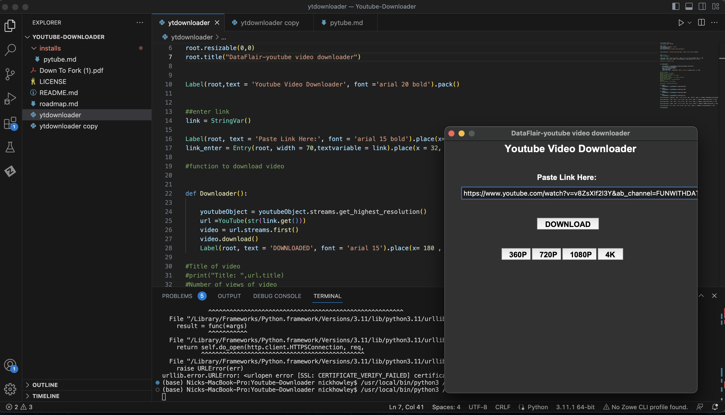
Ever want to download a YouTube video and take it on the go? With the YouTube Downloader you can! With the ability to choose the download quality to help save on space and download playlists, this is the ultimate YouTube Tool.

